Slide 1

Machine Learning – Certification Program (Aug 2018)
Code Assignment – Module 7 (Decision Trees)
Phone : +91 9999658436
Offices : Bengaluru, New Delhi
Email : contact@cellstrat.com
Web : www.cellstrat.com
CellStrat™ Confidential. All Rights Reserved.

Slide 2
Module 7
Decision Trees

Slide 3

Questions
pima-decisionTree.ipynb (Set 1 code)
Decision Tree
1) Cell 5: Change the depth to 4. Plot the output tree. Does it change the accuracy
Notes:
Merge Sort?

Slide 4
Questions
Classification –Decision Trees - Basic Tutorial
Name – Classify IRIS flower dataset using Decision Trees
File “CellStrat - Decision Trees - Basic Tutorial.ipynb”
Q1) Run decision tree on the IRIS dataset with max depths of 3 and 4 and show the tree output. Explain the meaning of calculated gini impurity values in the leaf nodes.

Slide 5
Questions
Classification –Decision Trees - Basic Tutorial
Name – Classify IRIS flower dataset using Decision Trees
File “CellStrat - Decision Trees - Basic Tutorial.ipynb”
Q2) Predict and print class probability for Iris flower instance with petal_len 1 cm and petal_width 0.5 cm

Slide 6
Questions
Classification – Classification Decision Trees and KNN
Name – Classify the IRIS flower dataset using various classification algorithms
File “Classification - Decision Trees and KNN.ipynb”
Q1) This program produces classification boundaries for Iris flower dataset using 3 algorithms. What are the 3 algorithms ? Which is the best one for this problem and why ?

Slide 7
Questions
Classification – Classification Decision Trees and KNN
Name – Classify the IRIS flower dataset using various classification algorithms
File “Classification - Decision Trees and KNN.ipynb”
Q2) Add Logistic Regression classification to this program and compare classification output to previous algorithms ?

Slide 8
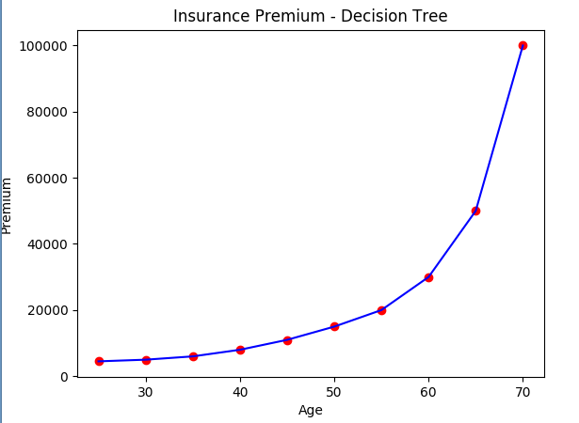
Questions
Regression – DTRegression
Tutorial name – Predict insurance premium per year based on person’s age using Decision Trees
File “DTRegression.ipynb”
Exercise :
Q1) Do you see any problem with the Decision Tree produced ? If yes, what is it ?
Q2) How you can solve overfitting here ?
Q3) Predict insurance value for persons with Age 55 ?

Slide 9
Questions
Regression – CellStrat Decision Trees Regression
Tutorial name – Generate random quadratic data and demonstrate Decision Tree regression.
File “CellStrat - Decision Trees – Regression.ipynb”
Exercises
Q1) Try changing max_depth for IRIS decision tree classifier from 2 to 3 to 4 and see the output. What do you see ?

Slide 10
Questions
Regression – CellStrat Decision Trees Regression
Tutorial name – Generate random quadratic data and demonstrate Decision Tree regression.
File “CellStrat - Decision Trees – Regression.ipynb”
Exercises
Q2) Try setting max_depth to 20 and see the output. What do you see ?

Slide 11
Questions
Regression – CellStrat Decision Trees Regression
Tutorial name – Generate random quadratic data and demonstrate Decision Tree regression.
File “CellStrat - Decision Trees – Regression.ipynb”
Exercises
Q3) For max_depth 2, what is the class prediction for petal_length = 3 cm and petal_width = 1 cm ?

Slide 12
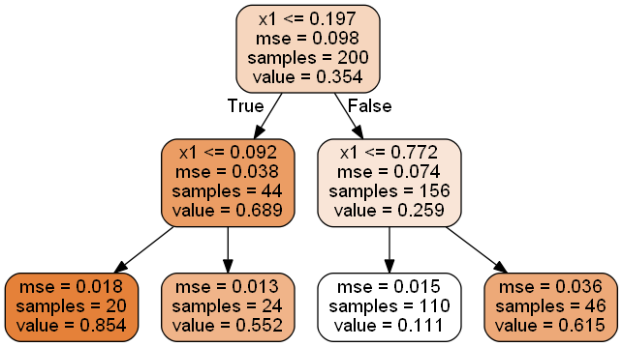
Questions
Regression – CellStrat Decision Trees Regression
Tutorial name – Generate random quadratic data and demonstrate Decision Tree regression.
File “CellStrat - Decision Trees – Regression.ipynb”
Exercises
Q5) For decision tree regression tree view plot, explain what is meant by mse, samples and value in each node ?

Slide 13
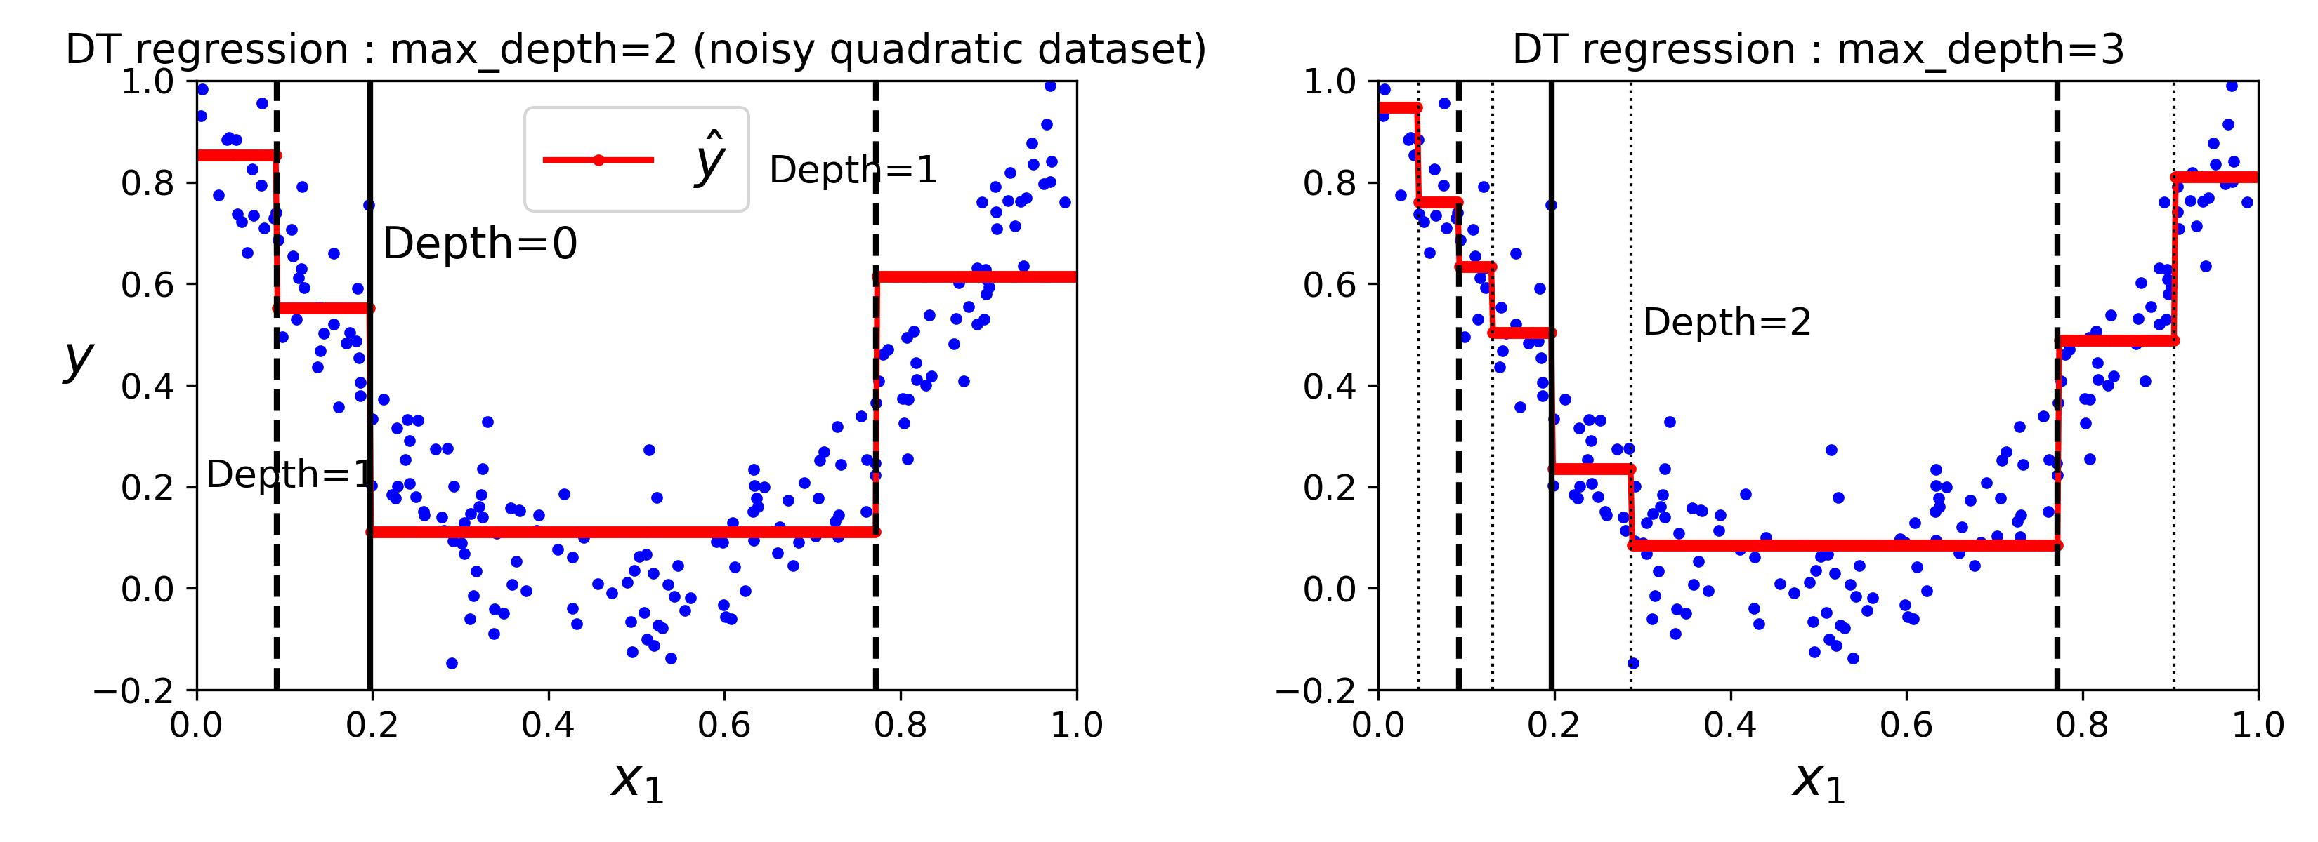
Questions
Regression – CellStrat Decision Trees Regression
Tutorial name – Generate random quadratic data and demonstrate Decision Tree regression.
File “CellStrat - Decision Trees – Regression.ipynb”
Exercises
Q6) Explain the Decision Tree regression graphs produce when max_depth is 2 and when max_depth is 3. How many leaf nodes exist in the two cases ? What does average value represent for these two situations ?

Slide 14
Questions
Regression – CellStrat Decision Trees Regression
Tutorial name – Generate random quadratic data and demonstrate Decision Tree regression.
File “CellStrat - Decision Trees – Regression.ipynb”
Exercises
Q7) What is average value of y for the node after the FIRST split when x1 <= 0.197 is TRUE ?

Slide 15
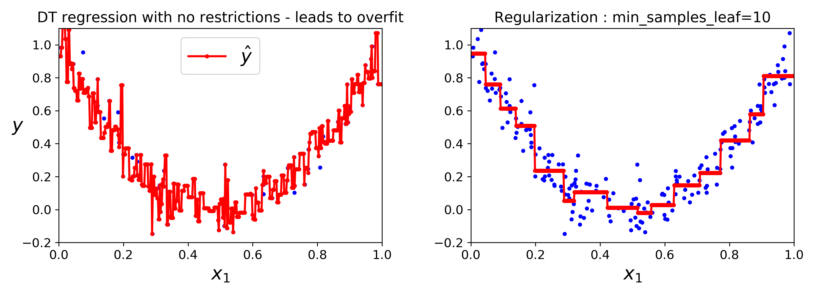
Questions
Regression – CellStrat Decision Trees Regression
Tutorial name – Generate random quadratic data and demonstrate Decision Tree regression.
File “CellStrat - Decision Trees – Regression.ipynb”
Exercises
Q8) When no restrictions are imposed on the growth of the decision tree, what happens ?

Slide 16
Questions
Regression – CellStrat Decision Trees Regression
Tutorial name – Generate random quadratic data and demonstrate Decision Tree regression.
File “CellStrat - Decision Trees – Regression.ipynb”
Exercises
Q9) Change the regularization parameter from min_sample_leaf=10 to max_leaf_nodes=6 and check output of Decision Tree regression. What is the result and why ?
Hint : code change is in Cell 24.

Slide 17
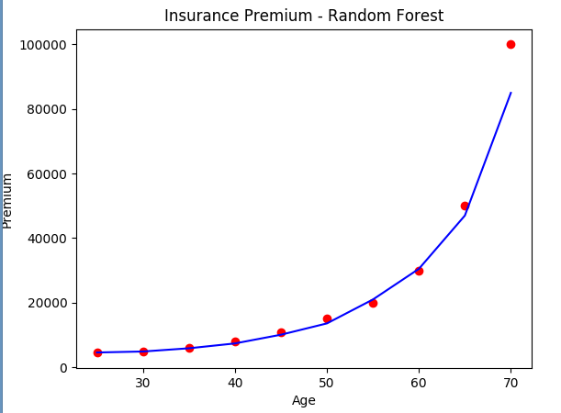
Questions
Regression – RFRegression
File “Rfregression.ipynb”
Tutorial name – Predict insurance per year based on person’s age using Random Forests
Exercises
Q1) Is the RFRegression better performer than Decision Tree Regression ? Why ? Can it cause overfitting ?
Q2) In the hands-on exercise, what is the output insurance value (roughly) for Age 60 with n_estimators = 10?

Slide 18
Questions
Regression – RFRegression
File “Rfregression.ipynb”
Tutorial name – Predict insurance per year based on person’s age using Random Forests
Exercises
Q3) In the code sample, change the no of n_estimators to 2 ? What happens and why ?

